Slide 1
CS118 – Programming Fundamentals
Lecture # 04
Tuesday, August 28, 2019
FALL 2019
FAST – NUCES, Faisalabad Campus
Course Instructor:
Ebad Majeed
Slides Credit:
Rizwan Ul Haq

Slide 2
Flowchart Common Symbols
Name | Symbol | Use in flowchart
Oval |  | Denotes the beginning or end of the program
Parallelogram |  | Denotes an input or an output
Rectangle |  | Denotes a process to be carried out (e.g. addition, subtraction etc.)
Diamond |  | Denotes a decision (or branch) to be made. The program should continue along one of two routes. (e.g. IF/THEN/ELSE)
Hybrid |  | Denotes and output message operation
Flow Line |  | Denotes the direction of logic flow in the program

Slide 3
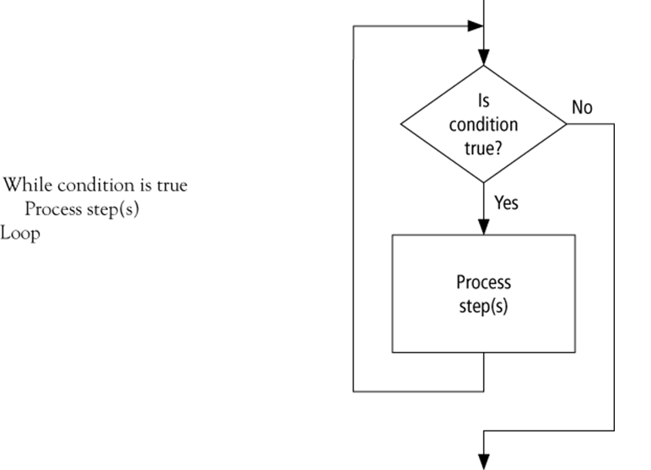
Looping flowchart

Slide 4
The Repetition Structure
In flowcharting one of the more confusing things is to separate selection from looping
This is because both structures use the diamond as their control symbol
In pseudocode we avoid this by using specific keywords to designate looping
WHILE/ENDWHILE
REPEAT/UNTIL

Slide 5
WHILE / ENDWHILE
Start
count = 0
WHILE count < 10
ADD 1 to count
WRITE count
ENDWHILE
WRITE “The End”
count = 0
count <10
Mainline
count = 0
WHILE count < 10
DO Process
ENDWHILE
WRITE “The End”
Process
ADD 1 to count
WRITE count
Write
“The End”
add 1 to
count
write count
Stop

Slide 6
REPEAT/UNTIL
Start
count = 0
REPEAT
ADD 1 to count
WRITE count
UNTIL count <= 10
WRITE “The End”
count = 0
add 1 to
count
Mainline
count = 0
REPEAT
DO Process
UNTIL count <= 10
WRITE “The End”
Process
ADD 1 to count
WRITE count
write count
count
<=10
Write
“The End”

Slide 7
Exercise Programs using Loop Structures

Slide 8
Exercise Program 1
Write pseudocode and draw a flowchart that will
Print first 10 odd numbers starting from the number provided by the user.
If it is even number then start from the next odd number if it is odd number then start with the current number
E.g. the user input 10 then the out put will be
11 13 15 17 19 21 23 25 27 29
If the user input 5 then the output will be
5 7 9 11 13 15 17 19 21 23
Hint: Use number mod 2 = 0 to determine the even number

Slide 9
Pseudocode for printing 10 of numbers
1. START
2. declare count, num
3. input num
4. if num mod 2 = 0 then
4.1 num = num + 1
5. end if
6. count = 0
7. while count < 10
7.1 print num
7.2 num = num + 1
7.3 count = count +1
8. end while
9. END

Slide 10
Flow chart for prtinting 10 odd numbers
START
1
Declare count, num
count = 0
Input num
count < 10
False
num mod 2 = 0
False
True
True
Print num
num = num +1
num = num + 2
count = count + 1
1
END

Slide 11
Exercise Program 2
Write a pseudocode and draw a flowchart to
Read an employee number (EMPNO), employee name (NAME), overtime hours worked (OVERTIME), hours absent (ABSENT) and
Determine the bonus payment (PAYMENT) for 10 employees one by one
Bonus Schedule
OVERTIME – (2/3)*ABSENT | Bonus Paid
>40 hours >30 but ≤ 40 hours >20 but ≤ 30 hours >10 but ≤ 20 hours ≤ 10 hours | $50 $40 $30 $20 $10

Slide 12
Exercise Program 3
Write a pseudocode and draw a flowchart to
Read an employee number (EMPNO), employee name (NAME), overtime hours worked (OVERTIME), hours absent (ABSENT) and
Determine the bonus payment (PAYMENT)
The program will keep on taking input and calculating until the user enters a –ve EMPNO
Bonus Schedule
OVERTIME – (2/3)*ABSENT | Bonus Paid
>40 hours >30 but ≤ 40 hours >20 but ≤ 30 hours >10 but ≤ 20 hours ≤ 10 hours | $50 $40 $30 $20 $10

Slide 13
Exercise Program 4: Average
Write a pseudocode and draw a flowchart
that will get 10 numbers from the user and print their average.
Use only one number as input i.e. n1
Hint: Use loop to get input in n1 and add it to Sum.

Slide 14
Exercise Program 5: Square/cube
Write a pseudocode and draw a flowchart for a program that will
Get one number from user
Print its square if it is an even number
Print its cube if it is and odd number
The loop will end if the provided number is a –ve number (Do not print square or cube of this –ve number)

Slide 15
Questions

